Slide 1


STEAME GOES HYBRID: Blueprint Guidelines and Policy Recommendations
Project Number: 2020-1-CY01-KA226-SCH-082675
This project has been funded with support from the European Commission.
This PowerPoint reflects the views only of the author, and the Commission cannot be held responsible for any use which may be made of the information contained herein.

Slide 2
Module n. 2
Introduction to STEAME HYBRID Learning and Creativity Plans
Project Number: 2020-1-CY01-KA226-SCH-082675

Slide 3
Module Structure
Introduction to the module and its aims
Presentation of the Blueprint Guidelines that refer to the development of the L&C Creativity Plans
Presentation of the L&C Plan template
Brief presentation of a STEAME GOES HYBRID L&C plan
Team Activity 1.1: Hybrid Scenarios and appropriate types of activities
Team Activity 1.2: Design of a STEAME HYBRID L&C Plan
Project Number: 2020-1-CY01-KA226-SCH-082675

Slide 4
Description
Introduction to the module and its aims
The STEAME activities are designed to be able to be implemented in a hybrid learning environment, in at least one of the forms that a hybrid learning environment has been described by the STEAME GOES HYBRID project.
To enable teachers to record their learning and creativity plan ideas in a way that will allow them to exchange ideas and practices, the project suggests the use of Learning and Creativity (L&C) plan template.
This module aims to train teachers in the use of the L&C plans both in recording their ideas and being able to comprehend and implement a L&C plan designed by one or more of their peers.
Project Number: 2020-1-CY01-KA226-SCH-082675

Slide 5
Learning Outcomes
Introduction to the module and its aims
Participants, upon completion should be able to:
Comprehend and use the Hybrid L&C Plans
Analyse and select the appropriate L&C Plans that align with the learning objectives they have set for their students
Develop a STEAME L&C plan that may be implemented in a hybrid learning environment
Project Number: 2020-1-CY01-KA226-SCH-082675

Slide 6
Hybrid Scenarios (1/4)
L&C Plans part of the Blueprint Guidelines
1. Camera showing the physical presentation
2. Physical students adapt to online students
3. Physical delivery of lesson with two cameras, one pointing the teacher and one the physically present students
Project Number: 2020-1-CY01-KA226-SCH-082675

Slide 7
Hybrid Scenarios (2/4)
L&C Plans part of the Blueprint Guidelines
4. Digital implementation of hands-on activities for all
5. Hands-on activities are done in the physical classrooms and the online students dictate the moves of those physically present
6. Activities with parallel on-line and physically completed tasks
Project Number: 2020-1-CY01-KA226-SCH-082675

Slide 8
Hybrid Scenarios (3/4)
L&C Plans part of the Blueprint Guidelines
7. Use of experiment simulation platforms
8. Use of portable of mobile phone camera to include online students in outdoor activities
9. Use of video learning material in hybrid learning scenarios
Project Number: 2020-1-CY01-KA226-SCH-082675

Slide 9
Hybrid Scenarios (4/4)
L&C Plans part of the Blueprint Guidelines
10. Online students perform physically hands-on activities at a later phase
11. Project based activities and full shift to online learning
12. Students collaborate online and perform hands-on activities in teams from different locations
Project Number: 2020-1-CY01-KA226-SCH-082675

Slide 10
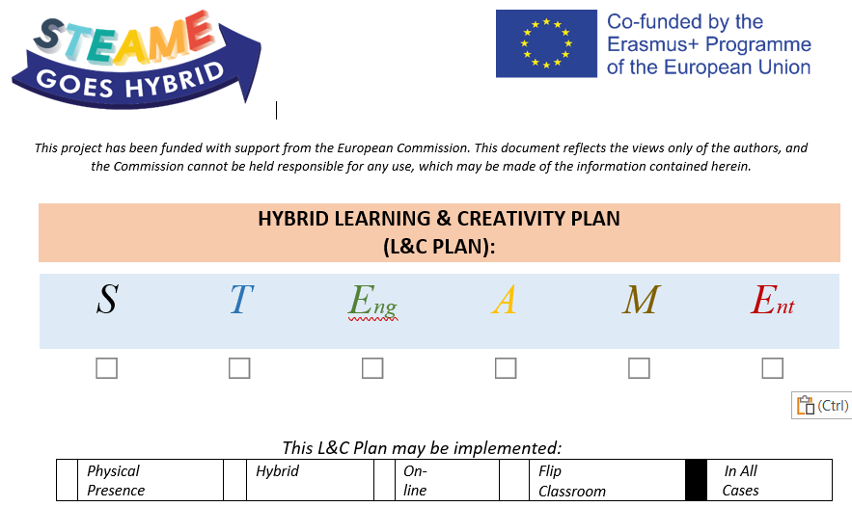
Template
Learning & Creativity Plan
Project Number: 2020-1-CY01-KA226-SCH-082675

Slide 11
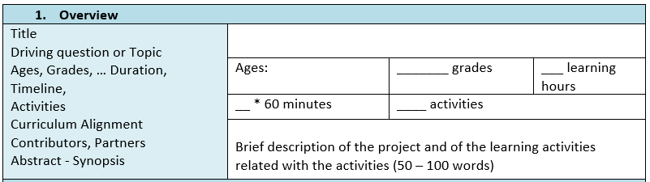
Template
Learning & Creativity Plan
Project Number: 2020-1-CY01-KA226-SCH-082675

Slide 12
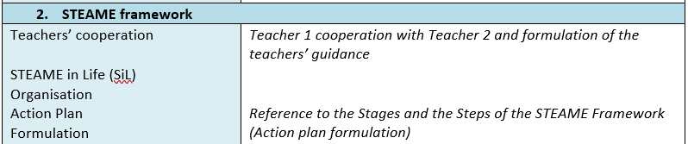
Template
Learning & Creativity Plan
Project Number: 2020-1-CY01-KA226-SCH-082675

Slide 13
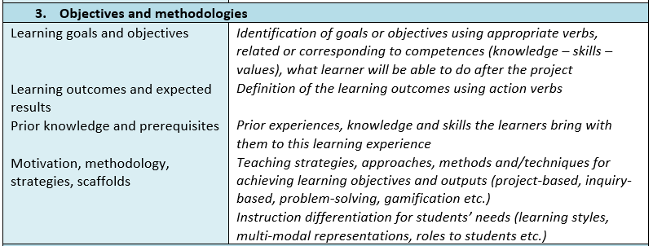
Template
Learning & Creativity Plan
Project Number: 2020-1-CY01-KA226-SCH-082675

Slide 14
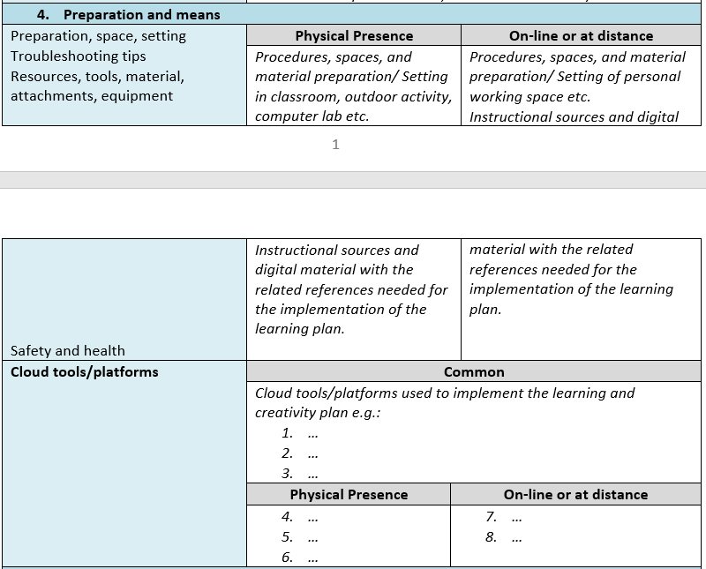
Template
Learning & Creativity Plan
Project Number: 2020-1-CY01-KA226-SCH-082675

Slide 15
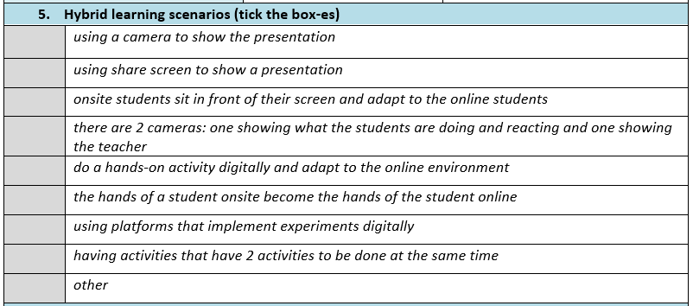
Template
Learning & Creativity Plan
Project Number: 2020-1-CY01-KA226-SCH-082675

Slide 16
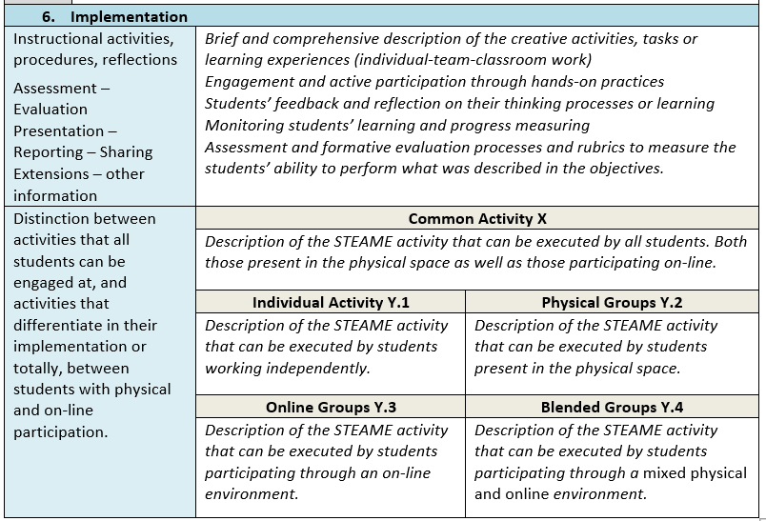
Template
Learning & Creativity Plan
Project Number: 2020-1-CY01-KA226-SCH-082675

Slide 17
Template
Learning & Creativity Plan
Project Number: 2020-1-CY01-KA226-SCH-082675

Slide 18
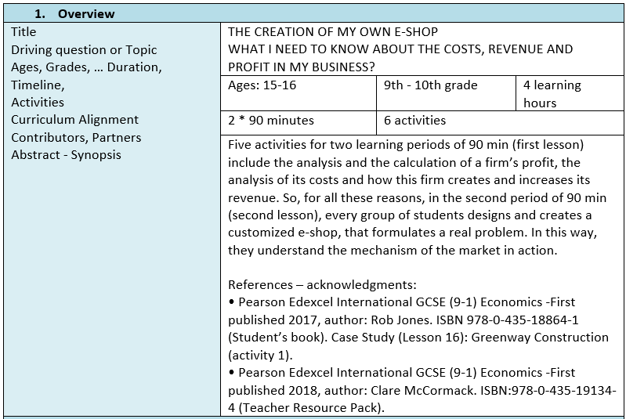
Example
Learning & Creativity Plan
Project Number: 2020-1-CY01-KA226-SCH-082675

Slide 19
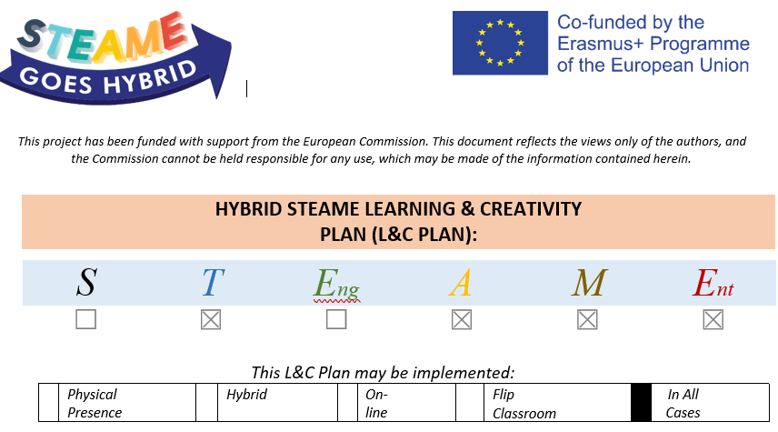
Example
Learning & Creativity Plan
Project Number: 2020-1-CY01-KA226-SCH-082675

Slide 20
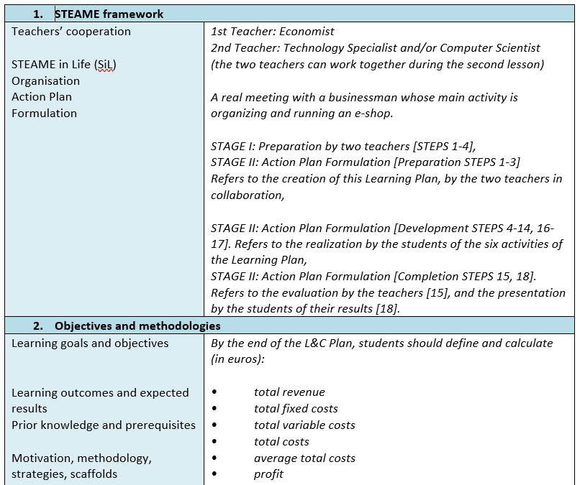
Example
Learning & Creativity Plan
Project Number: 2020-1-CY01-KA226-SCH-082675

Slide 21
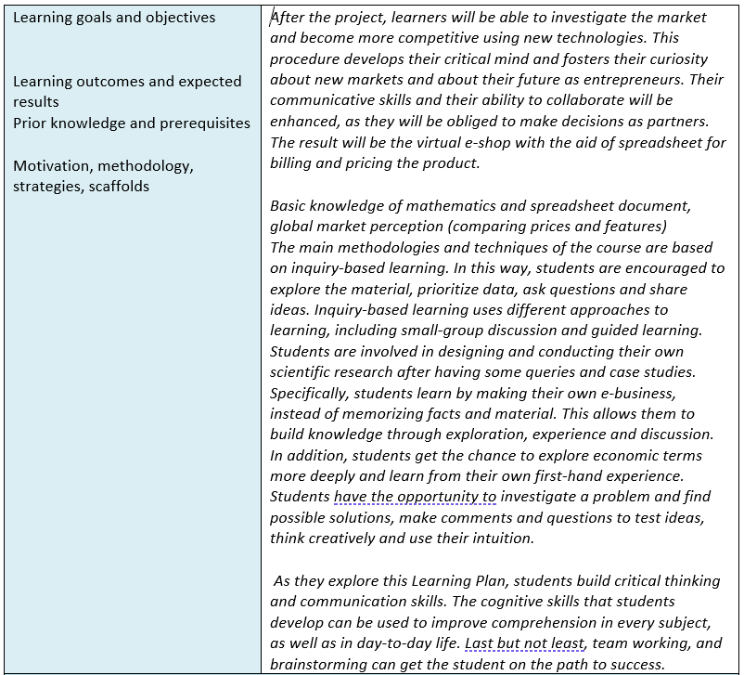
Example
Learning & Creativity Plan

Slide 22
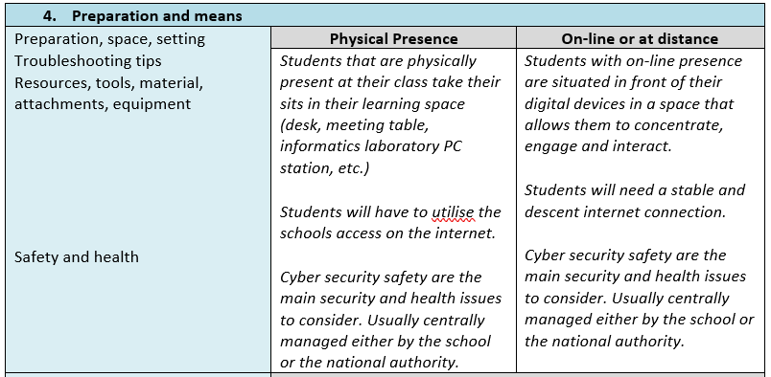
Example
Learning & Creativity Plan
Project Number: 2020-1-CY01-KA226-SCH-082675

Slide 23
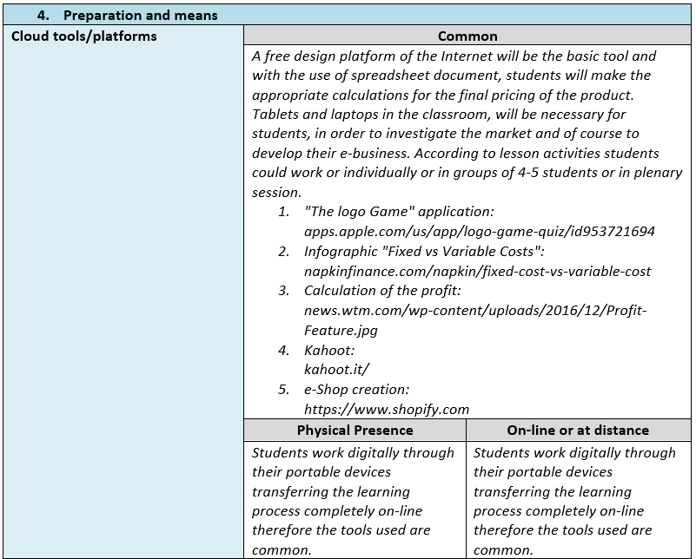
Example
Learning & Creativity Plan

Slide 24
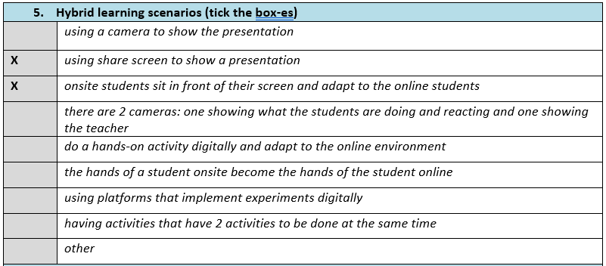
Example
Learning & Creativity Plan
Project Number: 2020-1-CY01-KA226-SCH-082675

Slide 25
Example
Learning & Creativity Plan
https://docs.google.com/document/d/1iSWfahEPop4H2sFyZWr-vA2WtJQ35NP4/edit?usp=sharing&ouid=114361955840157427497&rtpof=true&sd=true
Project Number: 2020-1-CY01-KA226-SCH-082675

Slide 26
Activity 1.1
Learning & Creativity Plan
Work in teams
Hybrid learning scenarios assignment
Think of two type of activities suitable for each of the scenarios assigned to your team
Project Number: 2020-1-CY01-KA226-SCH-082675

Slide 27
Activity 1.2
Learning & Creativity Plan
Work in teams
Think of a short learning and creativity plan
Use the L&C template to record the plan
(download the document, save and upload here your final version)
Document: https://bit.ly/LCplan_temp
Folder: https://bit.ly/module2_fold
Project Number: 2020-1-CY01-KA226-SCH-082675

Slide 28
Thank you!!
Project Number: 2020-1-CY01-KA226-SCH-082675

Slide 29




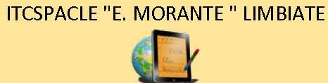



STEAME GOES HYBRID Partners
Project Number: 2020-1-CY01-KA226-SCH-082675

